Slide 1
D.C.G Project 2012 Exam Number: 120147

Slide 2
Part A

Slide 3
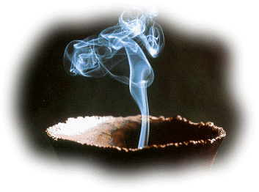
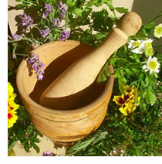
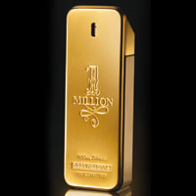
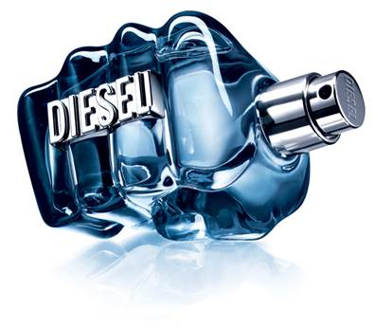
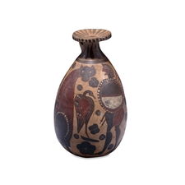
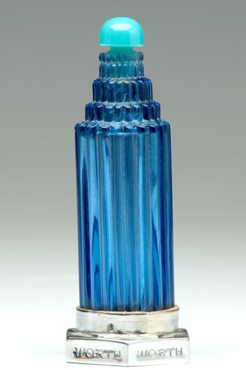
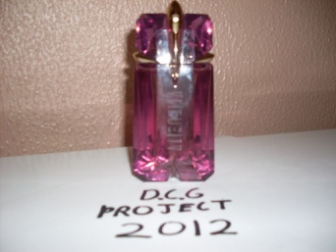
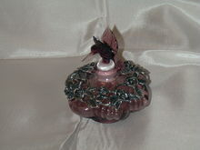
Design Research
Output 1
Perfume isn’t a recent invention in fact it has been around as long as humans have originating from Celtic druids who collected herbs and flowers for fragrance such as lavender or thyme or ancient Egyptian priests who burnt incense in their temples to please the gods.
But the first time containers were used to house perfume was in ancient Egypt and as you can guess their design was extremely basic and simple. The shapes and themes of these containers have evolved drastically over the years because whether it was vendors at an Egyptian market or modern perfume companies they all wanted the best looking bottles to beat off competition from their rivals and to attract the most customers. From then on the design and shape of these containers became more sophisticated and artistic leading to the ostentatious and delicately crafted perfume bottles we see today.
Ancient Times
Early Europe
1930’s
Modern Day
The earliest perfume vessels were made of stone like alabaster or of pottery with the bottle’s shape based on practicality making it easy to hold and transport. This is evident from the contrast between the wide belly of the bottle and it’s slender neck which makes pouring perfume out of the bottle easier. The Romans, Greeks and Egyptians revered nature often worshipping animals, using weather patterns as omens and star signs to predict their future and these practices were often reflected in the theme of the containers. This concept is represented excellently by the simple glazed clay carafe in the picture depicting a hunter surrounded by a bird and cat. This theme combined with it’s practicality would have made this container very popular at the time.
Early european perfume bottles were made from more expensive glass and metal with more intricate patterns and designs than the containers from ancient Rome, Greece and Egypt. However because of this new development the practicality of the containers declined being sacrificed instead for more aesthetically appealing shapes and designs. But the themes of the containers still retained an aspect from nature illustrated by the container in the picture portraying a hummingbird hovering above a flower preparing to collect the nectar. This effect is achieved through the purple glass hummingbird perched on the opening of the container and the detailed metallic floral motif encrusted with green gems and would have attracted any early European with an interest in nature and beauty.
During the depression in the 1930’s money was scarce and this had to be taken into account when the bottles were being manufactured. As a result the design of perfume bottles became more simple and cost effective and instead of being based on nature they began to resemble the buildings and the skyscrapers that dominated iconic cities like Paris and New York. The bottle in the picture follows this trend as you can see from it’s hexagonal base, cylindrical ridged body, and it’s multi tiered top leading up to a luminous light blue cap. This design resembles a skyscraper with a shining beacon sitting atop it’s uppermost level and along with it’s vibrant blue colour would have caught the eye of wealthy business men as a symbol of power and status, the very things they strived to achieve.
Nowadays after the immense economic growth of the past decade the design of perfume bottles is heavily influenced by their appearance with the vast majority of their prices coming from the use of expensive glasses and metals rather than the actual perfume itself. But this has to be done in order to compete in today’s highly competitive market and to influence the demanding consumer of the 21st century. The “Alien” bottle epitomizes the modern day bottle and it is evident from the picture below that a lot of time was spent in designing the bottle to tempt and lure customers into purchasing their product. The design is based around an extra-terrestrial theme indicated by the golden nozzle which is in the shape of a hooded alien head with the hole for ejecting the perfume acting as it’s singular eye similar to that of a Cyclops. The shape of the bottle is inspired by an asteroid and looks as if it came to earth from outer space with it’s lustrous purple glass giving the impression that it’s made of some precious stone and with it’s sharp contours make it very visually pleasing. This allows the bottle to have a very broad target market mainly aimed at women with a curiosity for the enigmatic and mysterious who appreciate complicated and interesting designs.

Slide 4
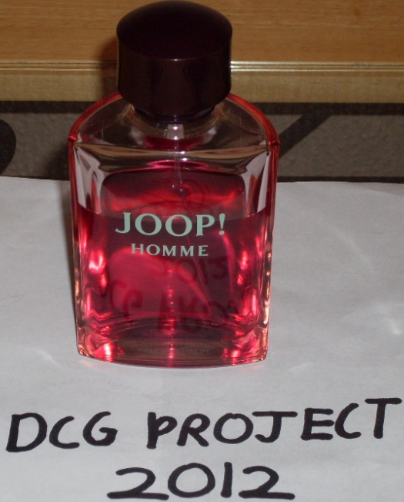
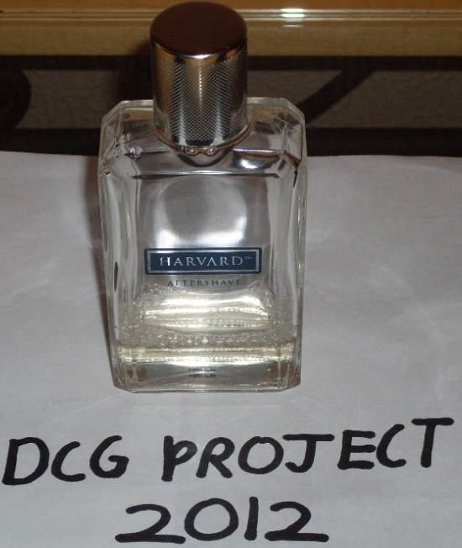
Design Feature Comparison
Output 2
Joop Homme | Feature | Harvard Aftershave
The shape of the Joop Homme bottle is based around a semi-circular prism with smooth chamfered edges giving the bottle a soft, delicate appearance. | Shells | However the shell of the Harvard bottle is centered around the shape of a cuboid with chamfered vertices and edges giving the bottle a very angular and rigid appearance.
The design of the cap for the Joop bottle is curved and circular as we can see from the dome on top of the broad, stout cylinder which is very similar to the rounded shape of the main body. | Lids | The cap of the Harvard bottle in contrast is longer and thinner leading to a simple, more refined shape in accordance with the angular design expressed by the main body.
The Joop bottle uses a spray mechanism to deliver the perfume where the spring in the mechanism is compressed by the nozzle which draws perfume up the straw where the nozzle then disperses the perfume into fine a mist or spray. The advantage of this particular design is that it transfers an exact amount each time no matter how hard you press down on the nozzle. | Delivery | The Harvard bottle in contrast uses a much simpler “splash” method to dispense it’s perfume. This technique merely involves tilting the bottle at such an angle that the perfume flows out the hole in the nozzle. However this design has an obvious flaw and that is because the amount of liquid released depends on how much liquid is in the bottle and the angle it is tilted and these factors are constantly varying making it difficult to predict the amount of perfume your going to get each time.
The colour scheme of the Joop bottle is very vibrant yet tranquil and this is achieved through the magenta coloured perfume and the dark purple lid. | Colour Scheme | Whereas the Harvard bottle’s colour scheme is much less visually appealing using a clear, transparent perfume and a plain, lustrous chrome lid.
The theme of the Joop bottle is focused primarily on the theme of love and romance. This is evident from the pink and purple colour scheme because these colours especially pink are considered the colours of love for example the pink love hearts on Valentines Day. The vibrant and tranquil magenta hue also represents the passionate emotions and warm feelings that exist when people are in love. The soft, rounded features of the shell and cap are also indicative of this romantic theme because their delicate appearance conveys the tender affections and care that two lovers have for each other. | Theme | On the other hand the theme of the Harvard aftershave is based around professionalism and precision expressed by the design features mentioned above. The angular, rigid design of the shell and the basic cylindrical lid give the bottle a very serious and business-like appearance because of it’s modest design. Even pouring out the perfume requires skill and accuracy which is in accordance with the theme of precision and professionalism being conveyed by the other features of the bottle’s design. The name of the bottle further contributes to the professional theme because everyone knows that Harvard is the best university in the world with the most skilled graduates who are unrivalled masters of their chosen professions.
As a result of the romantic theme being expressed by the bottle’s design it would obviously attract anyone who is interested in love or searching for love. As the name “Joop Homme” suggests the vast size and imposing nature of the bottle would especially suit men . Therefore this bottle would appeal to men aged between 20-40 with an interest in romance who will see it as a symbol of the love and passion they one day hope to share. | Target Market | I believe the theme of professionalism and precision being communicated by the bottle would catch the eye of professionals like engineers for example who thrive off accuracy and skill. As a result of the angular design and theme of this bottle the target market of this bottle would be the age of 30 and 50 year old men who appreciate efficiency and perfection.

Slide 5
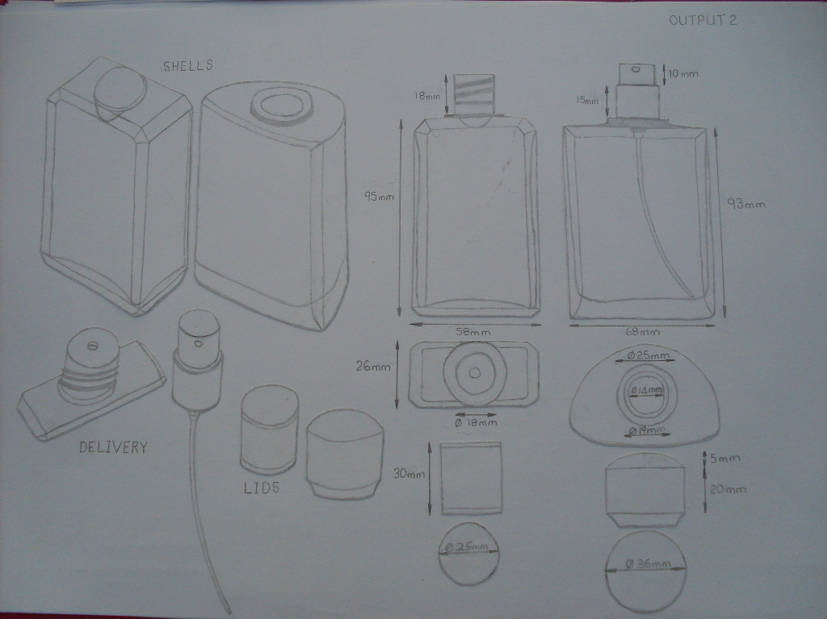

Slide 6
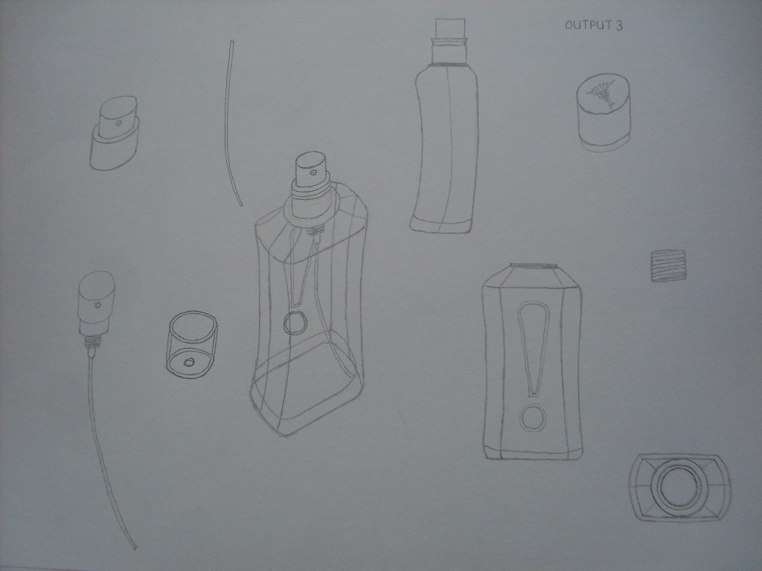

Slide 7
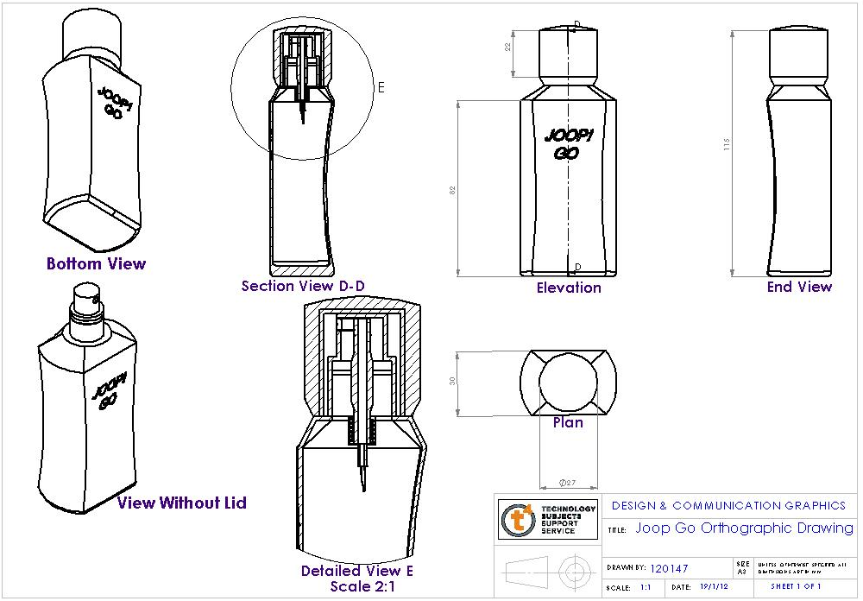
Output 5

Slide 8
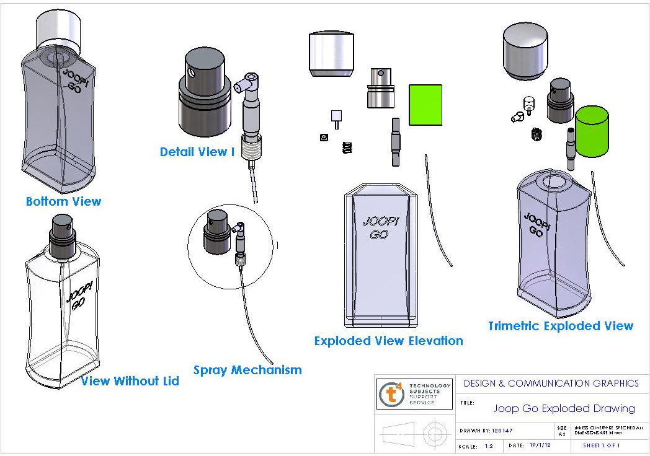
Output 5

Slide 9
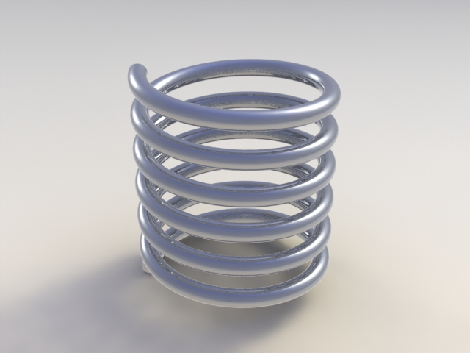
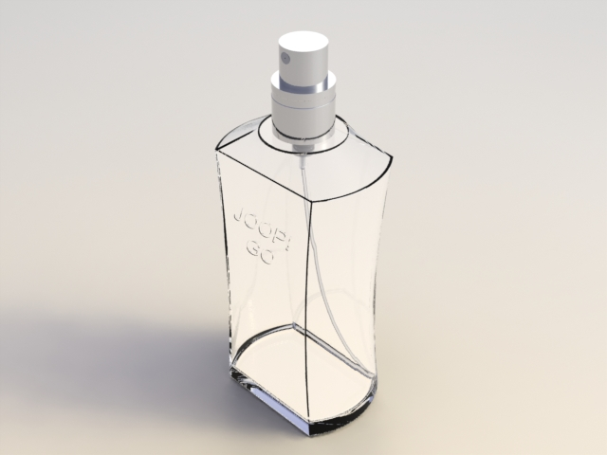
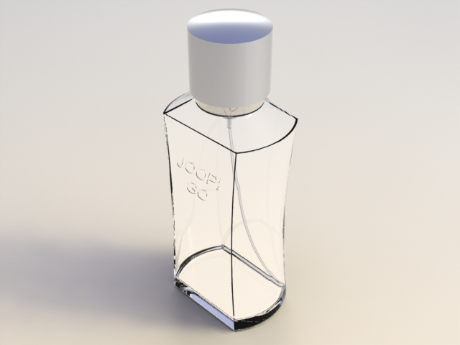
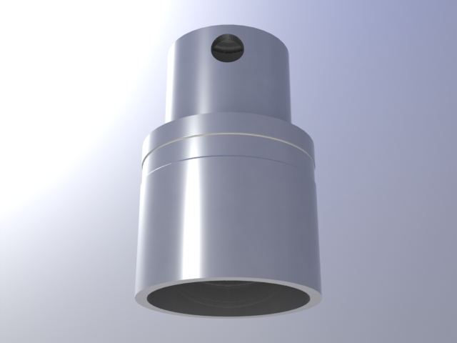
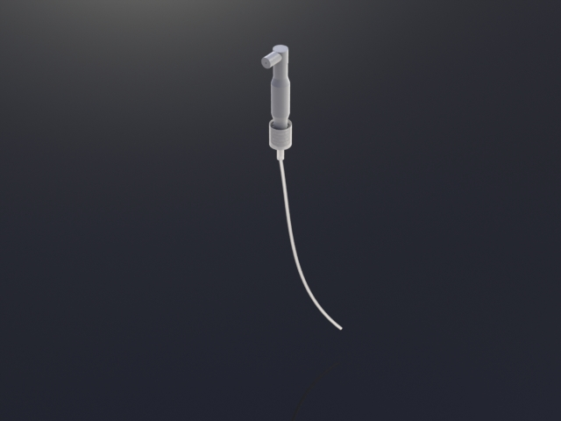
PhotoRealistic Images
Output 6

Slide 10
Part B

Slide 11
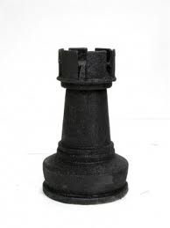
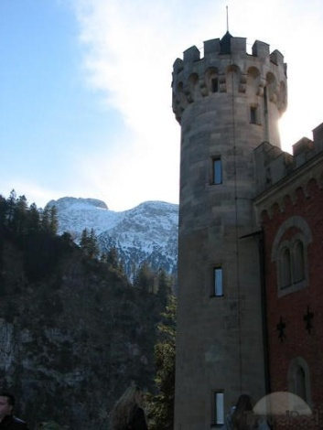
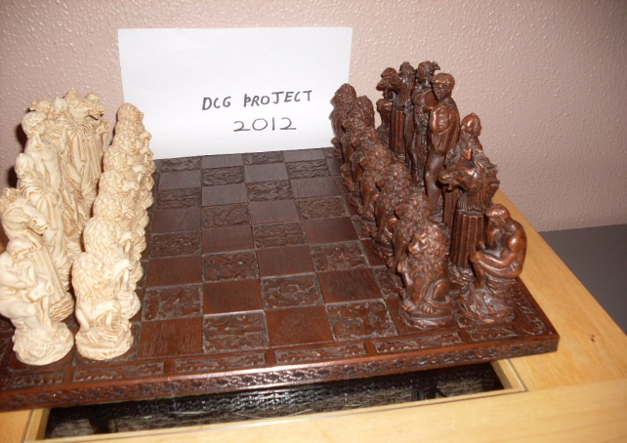
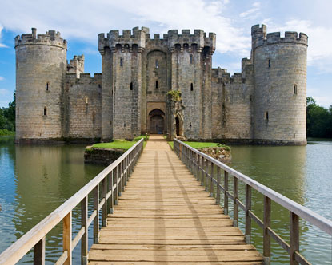
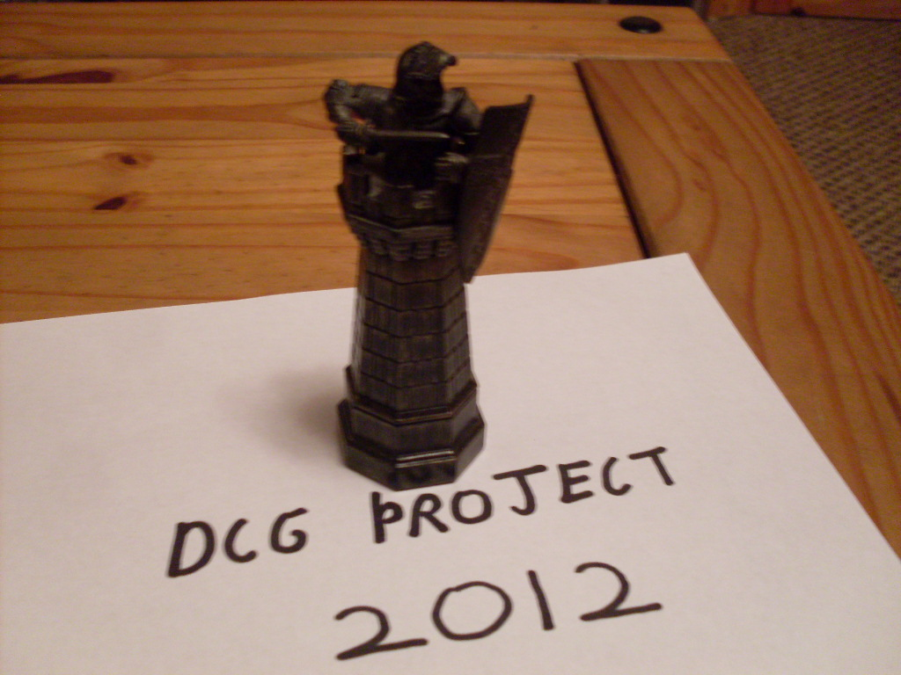
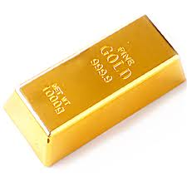
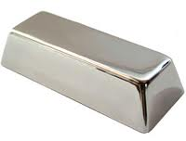
Design Inspiration
Output 7
My very first inspiration for my new concept design was when I was sitting in the living room thinking of possible designs for a bottle when I saw a chess set on the opposite side of the room. But unfortunately none of the pieces had the potential to be a perfume bottle because of their awkward designs. So I then began researching online focusing mainly on the rook because in general the rook was a more simple, less complicated piece than the others and would be the most practical to make a perfume bottle out of.
Some of the pieces in the chess sets I researched resembled medieval buildings like the rook in the second picture from the left so I began researching medieval architecture on the internet especially castles because that’s the piece of architecture that everyone associates with the middle ages. Then I began to notice the towers that clung to the side of the castles and it struck me that they would make the perfect shape for a perfume bottle.
Then I remembered that I had a rook from a Harry Potter chess set that would be perfect for my new design as it encapsulated both of the themes I wanted my bottle to express because it was a chess piece and it has a medieval design indicated by the knight. I decided that I would base the shape of my bottle around the varying octagonal tiers that gradually elongate into a tower as you can see in the picture. I would then use the battlement shaped top of the rook for my lid because I believed that the merlons and crenels added a complexity to the design and as a result would make it more aesthetically pleasing. Furthermore I thought that the octagonal structure while being very dynamic would also give the bottle a very rigid and linear appearance making the bottle more masculine because of it’s imposing nature.
In the medieval ages wealthy kings had vast amounts of silver and gold stashed in their treasure rooms and I thought it would be an excellent idea to incorporate these materials into my design to give it that wow factor. The rich and vibrant colours of these materials would give my bottle a more refined and elegant appearance which would make it more attractive to the target market.

Slide 12

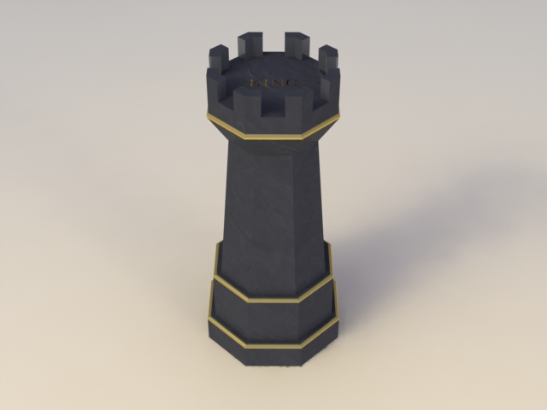
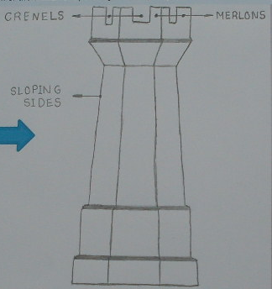
Design Investigation
Output 7
Environmental Sustainability
All the materials used in my bottle would all be reused or recycled materials to minimise the impact on the environment. For example the metal for the shell and spring of my bottle could be scrap metal from a car manufacturing company or the plastic components of the bottle like the straw could be from recycled plastic from coke or milk bottles. As well as that the packaging of the bottle such as the cardboard and the plastic film would all be 100% recyclable and this would be brought to the attention of the consumer by the adjacent recycling symbol.
Functionality
Aesthetics
This bottle is extremely practical and easy to use making the bottle very ergonomically friendly and a dream to use. One of the best features that accommodates the user is that it is very easy to grip due to the multi-faceted sides of the main length of the body and the sloping sides that make it easier for you to grip the bottle. In addition your it is simpler to hook your fingers under the lid and pull it off because of the hollow that is formed from the convergence of the sloping sides of the lid and the sloping sides of the body. These features combined with the very sturdy, stable octagonal base would make it one of the most consumer friendly bottles on the market.
I think this bottle is very visually appealing because of it’s rigid, stern design that stems from it’s octagonal tiers and the crown-like symmetrical pattern created by the merlons and crenels on top of the lid. Also the subtle contrast between the dark body of the bottle and the gold filleted edges combined with the elegant engraved writing on the lid give the bottle that opulent, refined appearance.
Theme And Branding
The theme of this bottle would be a theme of power which would be centred around a medieval theme and since the shape of the bottle resembles that of a tower of a medieval castle I believe the companies selling these bottles could take advantage of this design feature by using marketing slogans such as the ones below to encourage buyers by evoking the sense of power and status associated with the bottle. Every perfume bottle needs a name so I decided to call it “King” because it encapsulates the theme being conveyed by the design features of the bottle and when the consumer sees the name they will immediately recognise the medieval connection. These factors as a result will communicate a message to the consumer that it is a bottle associated with success and will act as a symbol to inspire and encourage them to achieve their goals and targets in life.
“Fragrance Fit For A King”
“Be The King Of Your Castle”
Target Market
The target market of this bottle would be men in the region of 25-50 but in particular business men. Because of the opulence and assertive nature of this bottle and the themes associated with it’s design I believe business men would see it as a symbol of power and status or for some a source of inspiration to achieve these things. Also because the design is centred around a chess piece it would also entice people who like to think on their feet, who enjoy using their brains to solve problems or to outshine the competition. Whether it’s fresh faced college graduates just out of college eager to make a name for themselves or hotshot C.E.O’s of multinational companies I believe they would jump at the chance to buy this bottle.

Slide 13
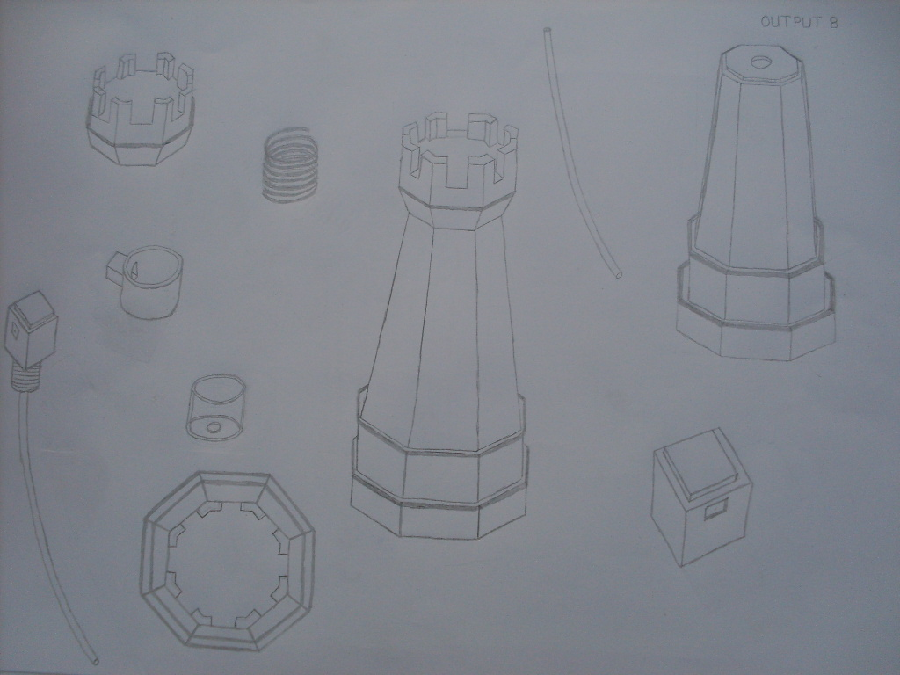

Slide 14
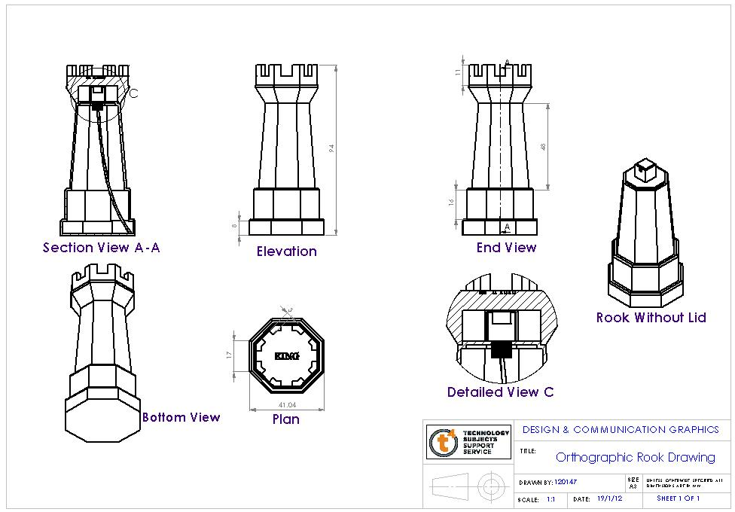
Output 9

Slide 15
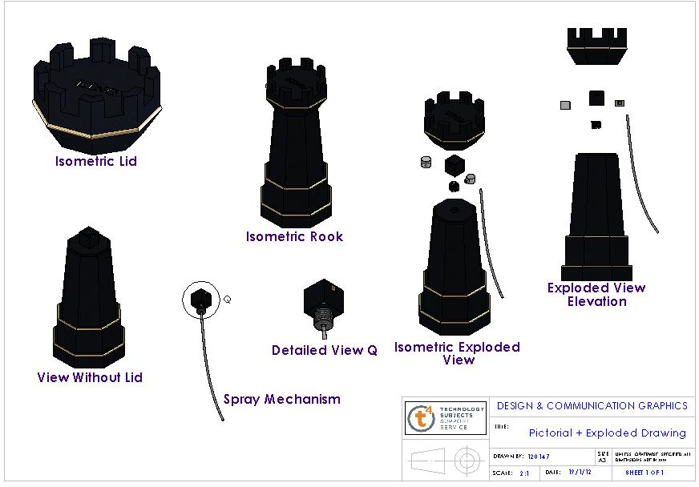
Output 9

Slide 16
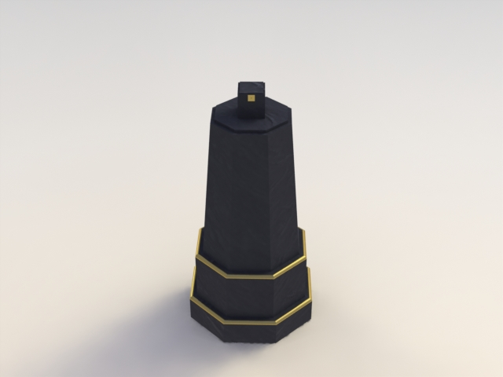
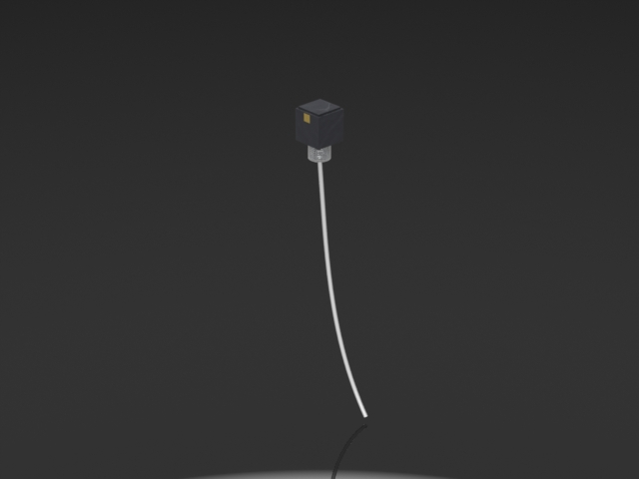
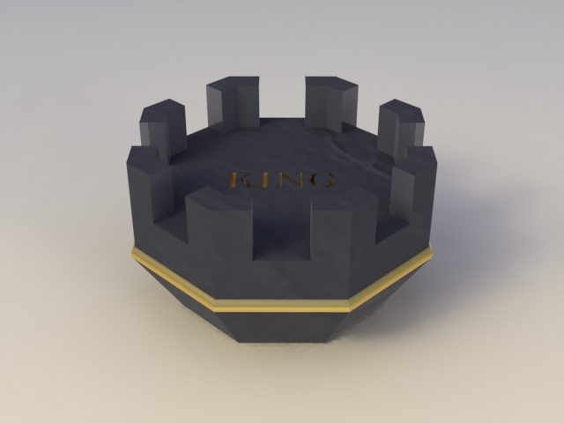
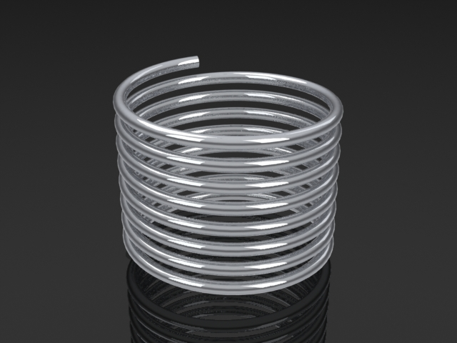
PhotoRealistic Images
Output 9

Slide 17
References
britishmuseum.org
incensemaking.com
ioffer.com
Perfumes.com
tourismplacesworld.blogspot
aboddington.worldpress.com
eventprophire.com
Google Images

